Slide 1
IBM – COURSERA DATASCIENCE CAPSTONE
SRIDHARAN CHANDRAN
18.08.2023

Slide 2
TOOLS FOR DATA SCIENCE

Slide 3
Data Science Tools and Ecosystem
Welcome to the presentation on Data Science Tools and Ecosystem.
In today's rapidly evolving technological landscape, data has become a cornerstone of decision-making and innovation.
Data Scientists play a pivotal role in extracting insights from vast datasets, enabling businesses to make informed choices.
This presentation offers a concise overview of the essential tools and languages that empower Data Scientists in their work.
As we delve into the intricacies of data science tools, we'll explore popular programming languages, essential libraries, and practical examples.
Let's embark on a journey through the dynamic world of Data Science and its indispensable tools.

Slide 4
POPULAR PROGRAMMING LANGUAGES
List the popular programming languages used by Data Scientists:
Python
SQL
R programming language
Julia
JavaScript
Scala
Java

Slide 5
Data Science Tools and Ecosystem
Popular Languages for Data Scientists:
Python:
General-purpose programming language for software development.
SQL (Structured Query Language):
Widely used for database manipulation and querying.
R Programming Language:
Statistical computing and graphics.
Julia, JavaScript, Scala, Java:
Diverse languages with specific applications in data science.

Slide 6
COMMONLY USED LIBRARIES
List the commonly used libraries by Data Scientists
TensorFlow
Numpy
SciPy
Pandas
Matplotlib
Keras
SciKit-Learn
PyTorch

Slide 7
Overview of Specific Tools
Sl. No. | Tools Name
1 | Numpy
2 | Pandas
3 | Scikit-Learn
4 | SciPy
5 | Matplotlib

Slide 8
Examples of Arithmetic Evaluation in Python
Evaluate arithmetic expressions using eval() function
# Initial expression
text = "4 * 6 - 3"
# Print original string
print("Original string is : " + text)
# Expression evaluation using eval()
result = eval(text)
print(result)
Output:
Original string is : 4 * 6 - 3
21

Slide 9
Converting Minutes to Hours
Total_minutes = 200
Minutes_per_Hour = 60
Total_Hours = Total_minutes / Minutes_per_Hour
print(Total_Hours)
Output:
3.3333333333333335

Slide 10
Objectives
Understand the prominent languages utilized by Data Scientists.
Recognize the significance of various programming languages in data science.
Explore essential libraries for data analysis and manipulation.
Gain insights into evaluating arithmetic expressions and unit conversions in Python.

Slide 11
Data Science Methodology

Slide 12
Credit Card Analysis
Welcome to today's presentation on the application of Data Science Methodology to Credit Card Analysis.
In this session, we will explore how data science techniques can be leveraged to address a critical challenge in the banking industry: determining client suitability for credit card issuance.
As the financial landscape continues to evolve, banks face the complex task of assessing the creditworthiness of potential clients.

Slide 13
Credit Card Analysis
Accurate credit card suitability assessment is essential to mitigate risks, ensure responsible lending practices, and maintain healthy financial portfolios.
By applying data science methodology, we can create predictive models that analyze a range of variables to make informed decisions about credit card approvals.
Let's delve into the details of this process and understand how data-driven insights are transforming the credit card issuance process for both clients and financial institutions.

Slide 14
BUSINESS UNDERSTANDING
Role Play: In our exploration of credit card analysis, let's step into the shoes of both the client and the data scientist. We'll envision the challenges faced by banks and how data science can provide solutions.
The Problem: The core issue we address is how banks can effectively determine if a client is suitable for obtaining a credit card based on their economic strength.
Question Framing: Can we leverage data-driven insights to automatically assess whether a client is suitable to obtain a credit card?

Slide 15
ANALYTIC APPROACH
Classification Model: To tackle the problem at hand, we will adopt a classification model, which aims to provide a binary "Yes" or "No" answer.

Slide 16
DATA REQUIREMENTS
Personal Data: The success of our classification model hinges on the availability of comprehensive personal data of bank clients. This data should encompass both clients who defaulted on payments and those who did not.

Slide 17
DATA COLLECTION
Descriptive Statistics: We will employ descriptive statistics to summarize and analyze the gathered data, ensuring it meets the prerequisites for our model.
Data Evaluation: Rigorous data evaluation techniques will be applied to ensure that the data collected is relevant and provides valuable insights.

Slide 18
DATA UNDERSTANDING AND PREPARATION
Data Understanding: In this phase, we will dive deep into our data, evaluating variables and calculating essential univariate statistics. We'll also investigate correlations between variables.
Data Preparation: To prepare our data for the classification model, we'll transform and preprocess it as required. This step is crucial to ensure that the model receives the necessary input.

Slide 19
MODELING AND EVALUATION
Modeling Phase: Here, we'll construct a classification model using the meticulously prepared data. This model will be trained to make accurate predictions regarding credit card suitability.
Evaluation Process: The model's performance will be rigorously evaluated, and iterative improvements will be made to enhance accuracy and predictive power.

Slide 20
CONCLUSION
Methodology Recap: To sum up, we have explored the various stages of the Data Science Methodology applied to credit card analysis, from problem framing to model evaluation.
Critical Importance: Accurate credit card suitability assessment is a critical aspect of responsible lending, risk management, and ensuring positive financial outcomes for both clients and institutions.
Thank You: Thank you for your attention. By embracing data science, we can drive transformation in the banking sector and ensure that credit card issuance aligns with clients' economic capabilities.

Slide 21
PYTHON PROJECT FOR DATA SCIENCE

Slide 22
INTRODUCTION
Introduction to stock data extraction & visualization
Extracting and visualizing stock data is essential for informed decision-making in data science projects.
In this presentation, we'll explore a project that involves extracting stock and revenue data and creating visualizations.
By the end, you'll have a clear understanding of the process and its significance.

Slide 23
PROJECT OVERVIEW
Objective: Extract stock and revenue data, create informative visualizations.
Tools Used: yfinance, pandas, requests, BeautifulSoup, plotly.
Tasks:
Stock data extraction for Tesla and GameStop.
Web scraping for revenue data.
Visualizing stock and revenue data.

Slide 24
Overview of Tasks
Define a Function that Makes a Graph
Use yfinance to Extract Stock Data
Use Webscraping to Extract Tesla Revenue Data
Use yfinance to Extract Stock Data
Use Webscraping to Extract GME Revenue Data
Plot Tesla Stock Graph
Plot GameStop Stock Graph

Slide 25
Purpose and Goals:
In this assignment, our main objective is to extract essential stock data and leverage visualization techniques to empower informed decision-making. By harnessing the power of data analysis and visualization, we aim to uncover meaningful insights that drive effective choices in the realm of stock investments.
Importance of Data Analysis and Visualization:
Data analysis and visualization are pivotal pillars of data science. They allow us to transform raw data into actionable insights, providing a clear understanding of complex trends, patterns, and relationships. Through insightful visualizations, we not only communicate information effectively but also unlock the potential for deeper comprehension, enabling us to navigate the intricate landscape of stock data with confidence.
Key Takeaways:
Understanding the significance of extracting and visualizing stock data.Realizing the power of data analysis and visualization in driving informed decisions.Exploring the intersection of data science and financial insights for strategic stock management.

Slide 26
TABLE OF CONTENTS
Define Graphing Function
Question 1: Tesla Stock Data Extraction
Question 2: Tesla Revenue Data Extraction
Question 3: GameStop Stock Data Extraction
Question 4: GameStop Revenue Data Extraction
Question 5: Plot Tesla Stock Graph
Question 6: Plot GameStop Stock Graph
Conclusion

Slide 27
Extracting and Visualizing Stock Data
Description:
Extracting essential data from a dataset and displaying it is a fundamental aspect of data science.
Enables informed decision-making based on data insights.
Subtasks:
Use yfinance to Extract Stock Data:
Utilize the yfinance library to extract historical stock data.
Retrieve and process stock data for Tesla (TSLA) and GameStop (GME) stocks.
Use Webscraping to Extract Revenue Data:
Apply web scraping techniques to gather revenue data for Tesla and GameStop.
Enhance data analysis by incorporating revenue insights.
Plot Historical Stock Graphs:
Create interactive visualizations of historical share prices and revenues.
Utilize Plotly and subplots to present both data sets in a single graph.

Slide 28
Data Visualization and Interpretation
Description:
Visualize extracted data to identify patterns, trends, and relationships.
Interpretation of data aids in drawing meaningful conclusions.
Subtasks:
Plot Tesla Stock Graph:
Generate a graph depicting Tesla's historical stock performance.
Compare share prices and revenues over time.
Plot GameStop Stock Graph:
Visualize GameStop's historical stock trends and revenue growth.
Analyze patterns in share prices and revenue data.
Estimated Time Needed: 30 min
Presentation of task details and concepts.
Code execution and graph visualization.
Q&A session for clarifications and discussion.

Slide 29
Defining the Graphing Function
def make_graph(stock_data, revenue_data, stock):
fig = make_subplots(rows=2, cols=1, shared_xaxes=True, subplot_titles=("Historical Share Price", "Historical Revenue"), vertical_spacing = .3)
fig.add_trace(go.Scatter(x=pd.to_datetime(stock_data.Date, infer_datetime_format=True), y=stock_data.Close.astype("float"), name="Share Price"), row=1, col=1)
fig.add_trace(go.Scatter(x=pd.to_datetime(revenue_data.Date, infer_datetime_format=True), y=revenue_data.Revenue.astype("float"), name="Revenue"), row=2, col=1)
fig.update_xaxes(title_text="Date", row=1, col=1)
fig.update_xaxes(title_text="Date", row=2, col=1)
fig.update_yaxes(title_text="Price ($US)", row=1, col=1)
fig.update_yaxes(title_text="Revenue ($US Millions)", row=2, col=1)
fig.update_layout(showlegend=False,
height=900,
title=stock,
xaxis_rangeslider_visible=True)
fig.show()
Introduction to the make_graph function used for creating stock and revenue graphs.
The function takes dataframes with stock and revenue data along with the stock name.

Slide 30
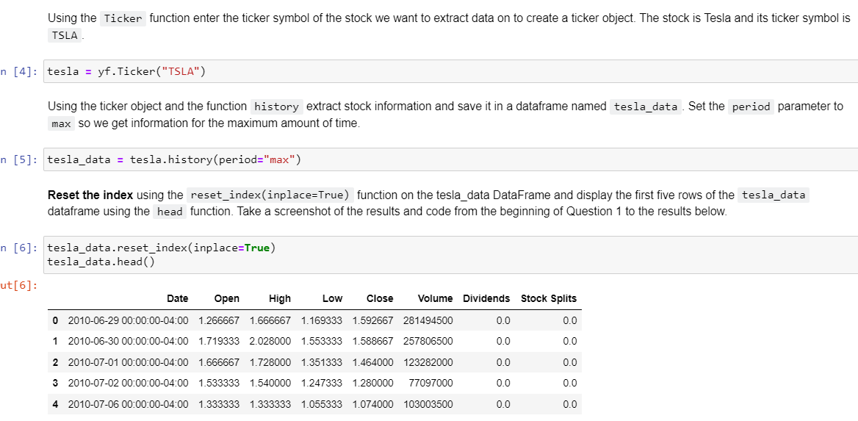
Tesla Stock Data Extraction

Slide 31
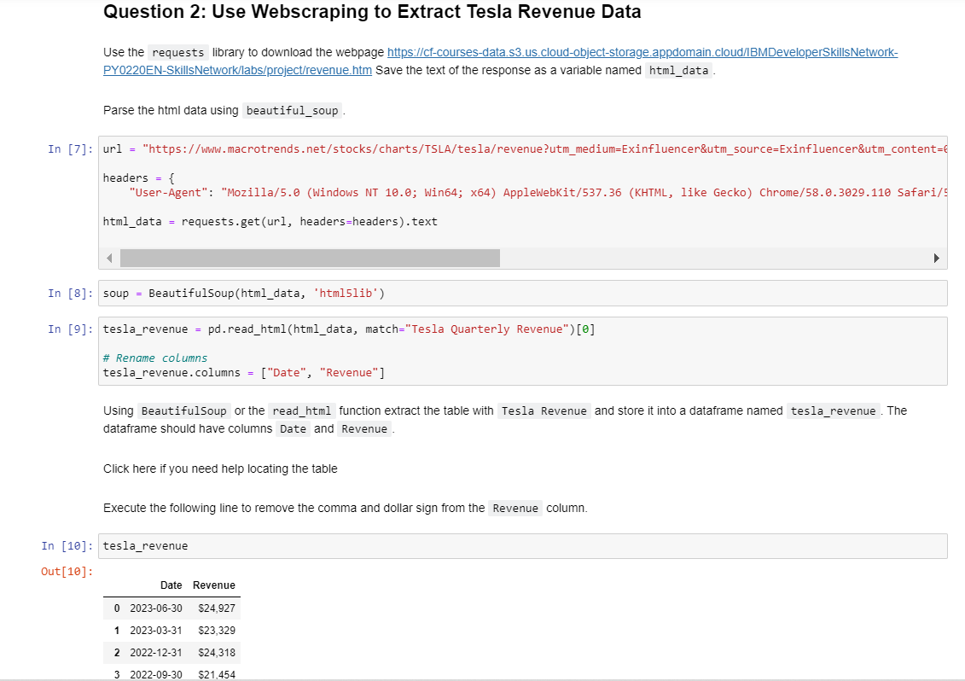
Tesla Revenue Data Extraction

Slide 32
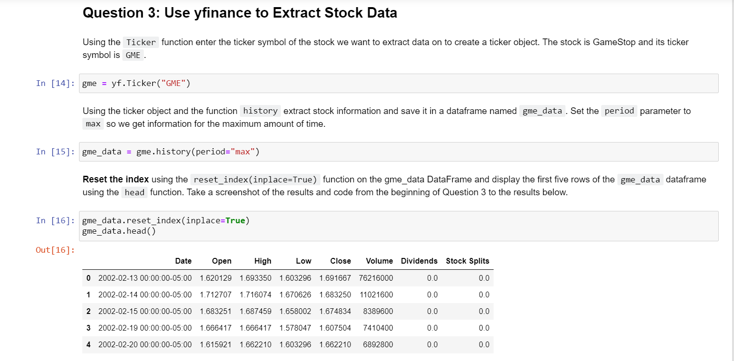
GameStop Stock Data Extraction

Slide 33
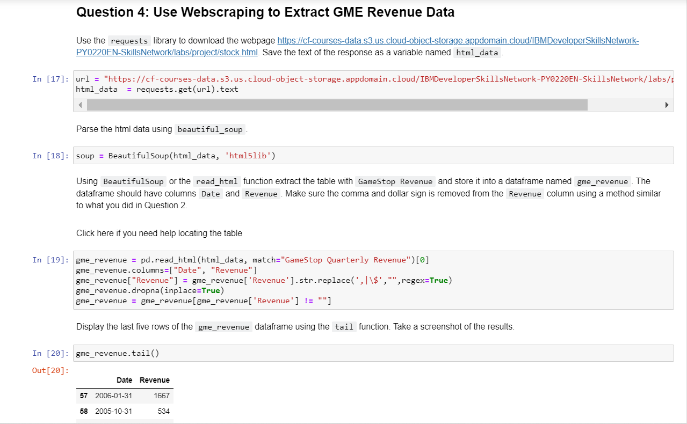
GameStop Revenue Data Extraction

Slide 34
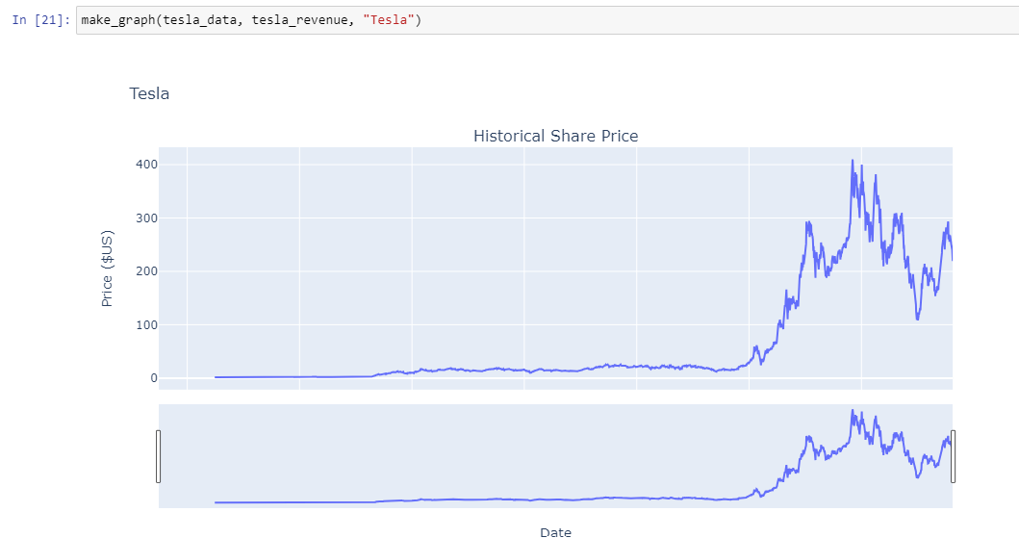
Plot Tesla Stock Graph

Slide 35
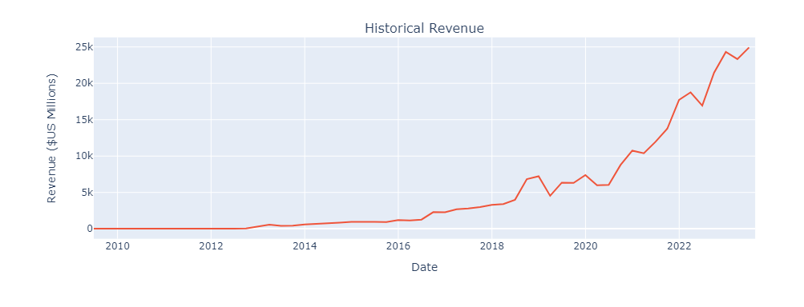
Plot Tesla Stock Graph

Slide 36
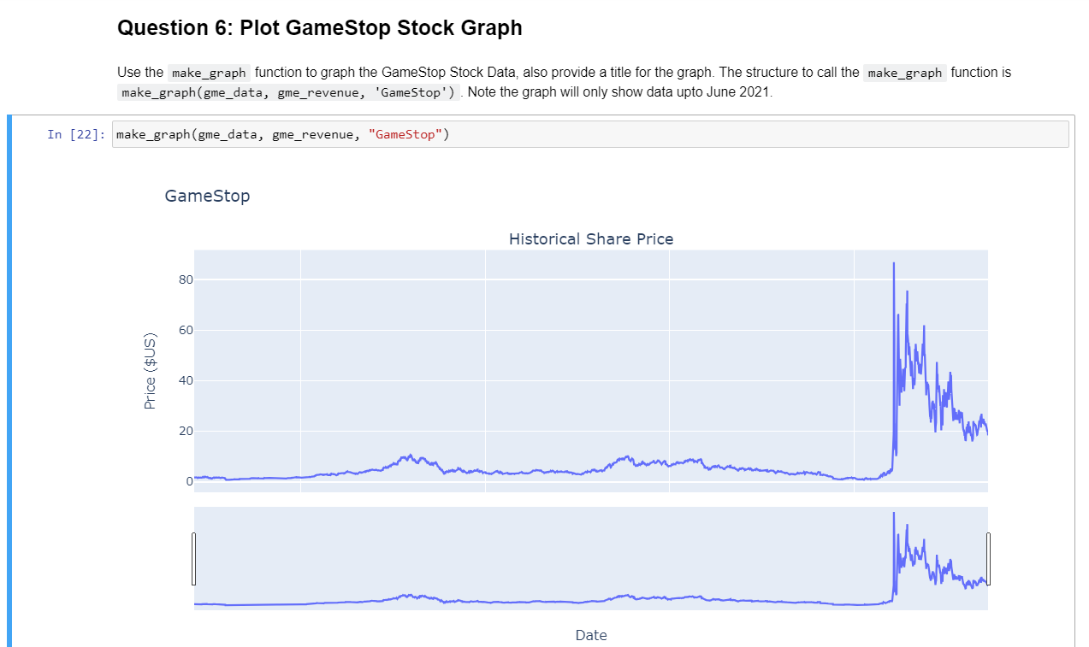
Plot GameStop Stock Graph

Slide 37
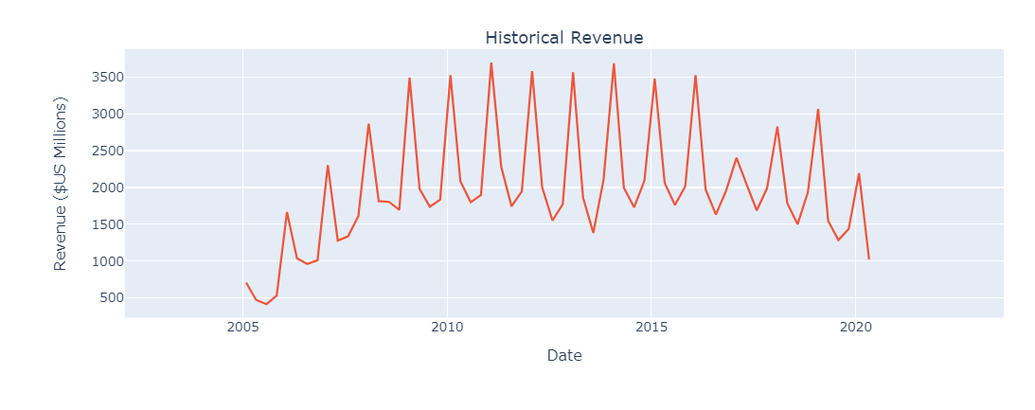
Plot GameStop Stock Graph

Slide 38
Conclusion
Extracting and visualizing stock data is crucial for data-driven decision-making.
The project showcased the process of data extraction, web scraping, and visualization.
Data visualization empowers us to gain insights and make informed choices.

Slide 39
DATABASE AND SQL FOR DATA SCIENCE WITH PYTHON

Slide 40
Exploring Chicago Datasets
Analyzing Socioeconomic Indicators, Schools, and Crime Data

Slide 41
Introduction
The primary objective of this presentation is to showcase how data analysis, specifically through SQL queries, can provide valuable insights into various facets of a city's dynamics. By utilizing real-world datasets, we aim to demonstrate the power of data-driven decision-making and its relevance in understanding complex urban environments.

Slide 42
Datasets Overview
Socioeconomic Indicators in Chicago: This dataset provides a comprehensive set of socioeconomic indicators that shed light on the public health and well-being of different community areas within Chicago. It encompasses data from the years 2008 to 2012.
Chicago Public Schools: Our second dataset presents performance data from Chicago Public Schools, specifically focusing on the 2011-2012 academic year. This dataset offers valuable insights into the educational landscape of the city.
Chicago Crime Data: Lastly, we will delve into crime data from 2001 to the present, providing a deeper understanding of the city's safety and security trends over time.

Slide 43
Use of SQL Queries
To derive meaningful insights from these datasets, we will employ SQL queries. SQL, or Structured Query Language, is a powerful tool that enables us to interact with databases and retrieve specific information. Through carefully crafted SQL queries, we can unveil patterns, trends, and relationships within the data, thereby enhancing our understanding of Chicago's socioeconomic, educational, and safety dynamics.
As we progress through the presentation, you will witness firsthand how SQL queries can transform raw data into actionable insights. Let's embark on this journey of exploration and discovery, unraveling the multifaceted nature of the city of Chicago.
So, without further ado, let's dive into our analysis and see what the data has to reveal.

Slide 44
SQL Queries
Problem 1 - Total Number of Crimes
SELECT COUNT(*) AS TotalCrimes FROM CHICAGO_CRIME_DATA;
Problem 2 - Community Areas with Low Per Capita Income
SELECT COMMUNITY_AREA_NAME
FROM CENSUS_DATA
WHERE PER_CAPITA_INCOME < 11000;

Slide 45
Problem 3 - Crimes Involving Minors
SELECT CASE_NUMBER, PRIMARY_TYPE, DESCRIPTION
FROM CHICAGO_CRIME_DATA
WHERE DESCRIPTION LIKE '%MINOR%' OR PRIMARY_TYPE LIKE '%MINOR%';
Problem 4 - Kidnapping Crimes Involving Children
SELECT DISTINCT CASE_NUMBER, PRIMARY_TYPE, DATE, DESCRIPTION
FROM CHICAGO_CRIME_DATA
WHERE PRIMARY_TYPE = 'KIDNAPPING';

Slide 46
Problem 8 - Most Crime-Prone Community Area
SELECT COMMUNITY_AREA_NUMBER, COUNT(COMMUNITY_AREA_NUMBER) AS Frequency
FROM CHICAGO_CRIME_DATA
GROUP BY COMMUNITY_AREA_NUMBER
ORDER BY Frequency DESC
LIMIT 1;
Problem 9 - Community Area with Highest Hardship Index
SELECT COMMUNITY_AREA_NAME
FROM CENSUS_DATA
WHERE HARDSHIP_INDEX = (SELECT MAX(HARDSHIP_INDEX) FROM CENSUS_DATA);
Problem 10 - Community Area with Most Crimes
SELECT COMMUNITY_AREA_NAME
FROM CENSUS_DATA
WHERE COMMUNITY_AREA_NUMBER = (SELECT COMMUNITY_AREA_NUMBER FROM CHICAGO_CRIME_DATA
GROUP BY COMMUNITY_AREA_NUMBER
ORDER BY COUNT(COMMUNITY_AREA_NUMBER) DESC
LIMIT 1)
LIMIT 1;

Slide 47
Conclusion
1. Data-Driven Insights: Through the strategic use of SQL queries, we've been able to extract meaningful insights from three diverse datasets. Our analysis has showcased the power of data in uncovering hidden patterns, trends, and relationships within complex real-world scenarios.
2. Socioeconomic Landscape: Our examination of socioeconomic indicators has illuminated the disparities and challenges faced by different community areas within Chicago. We've identified areas with lower per capita income and higher percentages of households below the poverty line.
3. Educational Perspective: The analysis of Chicago Public Schools data has provided valuable insights into the educational landscape. We've explored safety scores across different school types, revealing variations in safety perceptions within the city's educational institutions.
4. Crime Trends and Hotspots: By diving into crime data, we've identified crime-prone community areas and specific types of crimes recorded at schools. This information is crucial for policymakers and law enforcement agencies to prioritize resources and enhance public safety.

Slide 48
5. Community Empowerment: Our findings empower communities with data-driven knowledge to advocate for positive change. By understanding hardship indices and poverty rates, communities can better address socio-economic challenges and work towards a brighter future.
6. Importance of Data Analysis: This analysis underscores the importance of data analysis in informed decision-making. It showcases how data-driven insights can guide policy formulation, resource allocation, and targeted interventions.
7. Continuous Learning: The world of data analysis is vast and ever-evolving. This presentation serves as a starting point, encouraging us to continue exploring, learning, and applying data-driven approaches to understand and transform our communities.
In closing, we've witnessed how data has the power to inform, guide, and inspire positive change. Let this be a reminder that behind every data point lies a story waiting to be told, and as data enthusiasts, we have the privilege of unraveling these stories for the betterment of society.

Slide 49
Data Analysis with Python

Slide 50
Introduction
Introduction to House Sales Data Analysis
Dataset: House sale prices in King County, USA (May 2014 - May 2015)
Features: id, date, price, bedrooms, bathrooms, sqft_living, sqft_lot, floors, waterfront, view, condition, grade, sqft_above, sqft_basement, yr_built, yr_renovated, zipcode, lat, long, sqft_living15, sqft_lot15

Slide 51
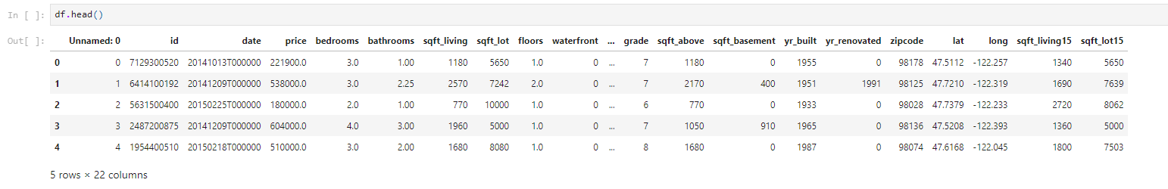
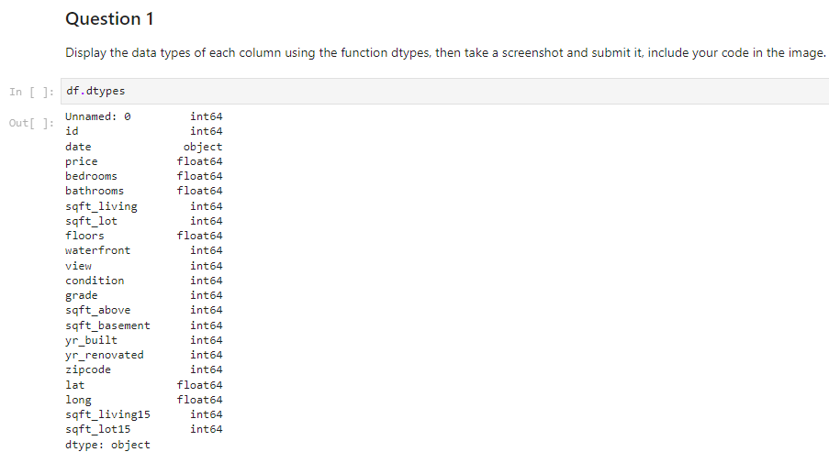
Dataset Overview
Display the first few rows of the dataset
Display data types of each column

Slide 52
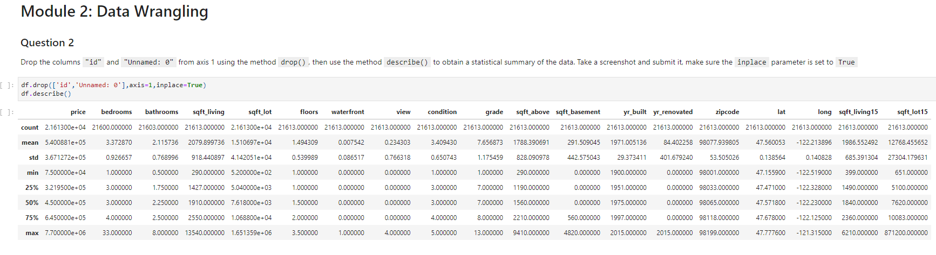
Data Summary
Display statistical summary of the dataset
Drop columns 'id' and 'Unnamed: 0'
Display updated statistical summary

Slide 53
Handling Missing Values
Replace missing values in 'bedrooms' and 'bathrooms'
Show the process of replacing missing values
# Replace missing values in 'bedrooms'
mean_bedrooms = df['bedrooms'].mean()
df['bedrooms'].replace(np.nan, mean_bedrooms, inplace=True)
# Replace missing values in 'bathrooms'
mean_bathrooms = df['bathrooms'].mean()
df['bathrooms'].replace(np.nan, mean_bathrooms, inplace=True)

Slide 54
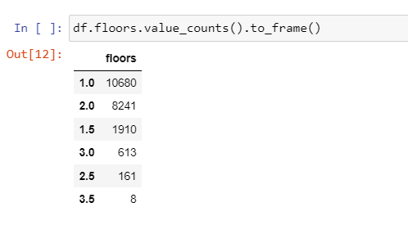
Exploratory Data Analysis
Count of Houses by Floors df['floors'].value_counts().to_frame()

Slide 55
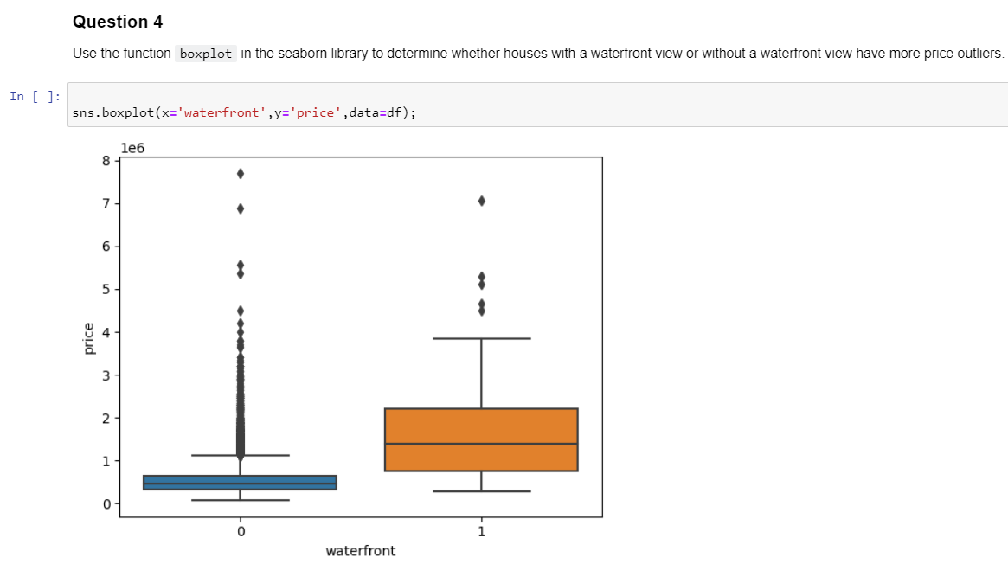
Waterfront View vs. Price
Price Outliers with Waterfront View
sns.boxplot(x='waterfront', y='price', data=df)

Slide 56
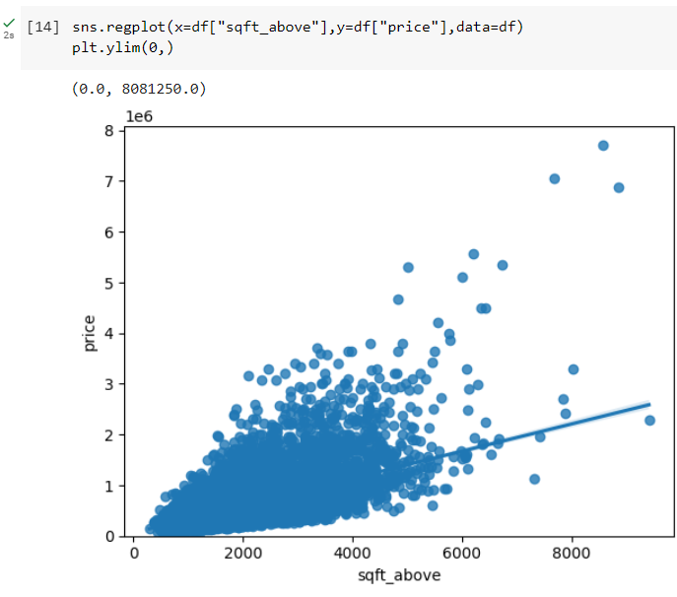
Sqft Above vs. Price
Sqft Above and Price
sns.regplot(x=df['sqft_above'], y=df['price'], data=df)

Slide 57
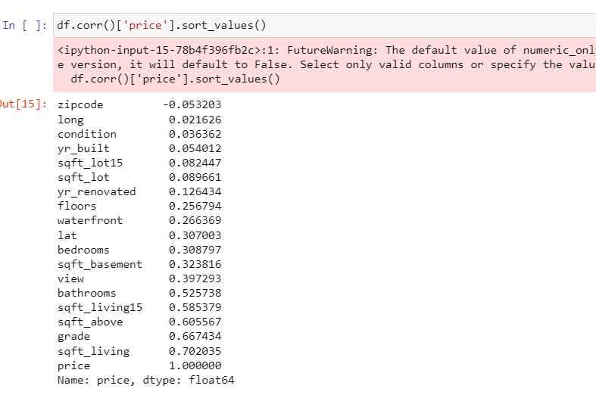
Feature Correlations
Correlation of Features with Price
df.corr()['price'].sort_values()

Slide 58
Linear Regression - Longitude
Predicting Price Using Longitude
X = df[['long']]
Y = df['price']
lm = LinearRegression()
lm.fit(X, Y)
lm.score(X, Y)

Slide 59
Linear Regression - Multiple Features
Predicting Price Using Multiple Features
features = ["floors", "waterfront", "lat", "bedrooms", "sqft_basement", "view", "bathrooms", "sqft_living15", "sqft_above", "grade", "sqft_living"]
x = df[features]
y = df['price']
lr.fit(x, y)
lr.score(x, y)

Slide 60
Pipeline and Ridge Regression
Creating a Pipeline and Ridge Regression
from sklearn.pipeline import Pipeline
from sklearn.preprocessing import StandardScaler, PolynomialFeatures
from sklearn.linear_model import LinearRegression, Ridge
features = ["floors", "waterfront", "lat", "bedrooms", "sqft_basement", "view", "bathrooms", "sqft_living15", "sqft_above", "grade", "sqft_living"]
X = df[features]
Y = df['price']
steps = [('scale', StandardScaler()), ('polynomial', PolynomialFeatures(include_bias=False)), ('model', LinearRegression())]
pipeline = Pipeline(steps)
pipeline.fit(X, Y)
pipeline.score(X, Y)

Slide 61
Model Evaluation and Refinement
from sklearn.model_selection import train_test_split
features = ["floors", "waterfront", "lat", "bedrooms", "sqft_basement", "view", "bathrooms", "sqft_living15", "sqft_above", "grade", "sqft_living"]
X = df[features]
Y = df['price']
x_train, x_test, y_train, y_test = train_test_split(X, Y, test_size=0.15, random_state=1)
rr = Ridge(alpha=0.1)
rr.fit(x_train, y_train)
rr.score(x_test, y_test)

Slide 62
Data Visualization with python

Slide 63
Introduction
The purpose of this presentation is to provide a comprehensive overview of our analysis and visualization of US domestic airline flight performance data.
Our focus is on delving into the intricacies of airline operations, revealing insights that can shape strategic decisions and enhance customer experiences.
To achieve this, we utilize a powerful tool: the Dash web application, which enables us to create interactive and dynamic visualizations of the data.
Through our analysis and the intuitive Dash interface, we aim to uncover hidden patterns, trends, and key performance indicators within the realm of US domestic air travel.

Slide 64
Dash Web Application
Dash is a robust Python web application framework designed for the creation of interactive and data-driven web applications.
With Dash, we harness the power of Python to seamlessly develop dynamic web experiences that cater to data analysis and visualization needs.
One of Dash's standout features is its ability to produce visually appealing and interactive data visualizations, making complex information more accessible and engaging.
In the context of our presentation, Dash serves as the perfect tool to unlock insights from US domestic airline flight performance data.
Our Dash application will be the gateway to exploring, understanding, and deriving valuable insights from the data, enabling us to make informed decisions and drive improvements in the airline industry.

Slide 65
Data Source
Our analysis is based on a comprehensive dataset that captures the US domestic airline flight performance.
This dataset provides a rich source of information, encompassing a wide range of attributes that shed light on various aspects of airline operations.

Slide 66
Key Features of the Dataset
Year: The year of the recorded flight data.
Month: The month of the recorded flight data.
Reporting Airline: The airline responsible for reporting the flight data.
Flights: Total number of flights for a given month and year.
AirTime: Average duration of flights, offering insights into efficiency and operations.
Cancellation Codes: Codes indicating reasons for flight cancellations.
Delay Data: Different types of delays, such as carrier, weather, NAS, security, and late aircraft delays.
This dataset serves as the foundation for our analysis, enabling us to perform various visualizations and derive meaningful insights.
By leveraging this data, we can uncover trends, patterns, and performance metrics that drive our understanding of US domestic airline operations and contribute to informed decision-making within the industry.

Slide 67
Year and Report Type Selection
Our analysis is presented through an interactive Dash web application, allowing users to engage with the data and explore insights in a dynamic and user-friendly manner.
USER INTERACTION:
Year Selection Dropdown:
Users can choose the year of interest within the range of 2005 to 2020.
This enables users to focus on specific timeframes and observe trends over the years.
Report Type Selection Dropdown:
Users have the option to select between two report types:
Yearly Airline Performance Report: Provides an overview of airline performance metrics.
Yearly Airline Delay Report: Focuses on different delay factors affecting airline operations.
The user's selections will drive the content and visualization of the Dash application, allowing for tailored exploration and analysis of the US domestic airline flight performance data.

Slide 68
Yearly Airline Performance Report
Diverted Airport Landings:
Presents the percentage of flights diverted to alternate airports per reporting airline.
Offers a perspective on airlines' operational flexibility and response to unforeseen circumstances.
Flight Counts by Origin State:
Visualizes the number of flights departing from each US state.
Helps identify significant departure hubs and regional flight patterns.
Through these visualizations, users can gain valuable insights into the overall performance and operational aspects of domestic airlines throughout the selected year.

Slide 69
Monthly Flight Cancellation
Insights:
Users can observe the variation in flight cancellations across different months.
Identification of peak cancellation months, possibly due to weather-related factors.
Analysis of the primary reasons for cancellations through cancellation codes.

Slide 70
Average Monthly Flight Time by Airline
Insights:
Comparison of average flight times among different reporting airlines over the year.
Identification of airlines with consistently shorter or longer flight durations.
Understanding the potential impact of flight duration on customer satisfaction and operational efficiency.

Slide 71
Diverted Airport Landings
Insights:
Assessment of the percentage of flights that were diverted to alternate airports by reporting airline.
Evaluation of airlines' adaptability in handling unexpected situations.
Identification of airlines with higher or lower rates of diverted flights.

Slide 72
Flight Counts by Origin State
Insights:
Visualization of flight departure hubs across different US states.
Recognition of major departure states and their contributions to overall flight volume.
Understanding of regional flight distribution and its impact on airline network coverage.

Slide 73
Yearly Airline Delay Report
This section of the report focuses on analyzing different types of flight delays throughout the year.
Types of Delay:
Carrier Delay: Delays caused by the airline, such as maintenance or crew issues.
Weather Delay: Delays attributed to weather conditions.
NAS Delay (National Aviation System): Delays due to factors like air traffic control, non-extreme weather, etc.
Security Delay: Delays related to security concerns.
Late Aircraft Delay: Delays caused by a previous flight being late.

Slide 74
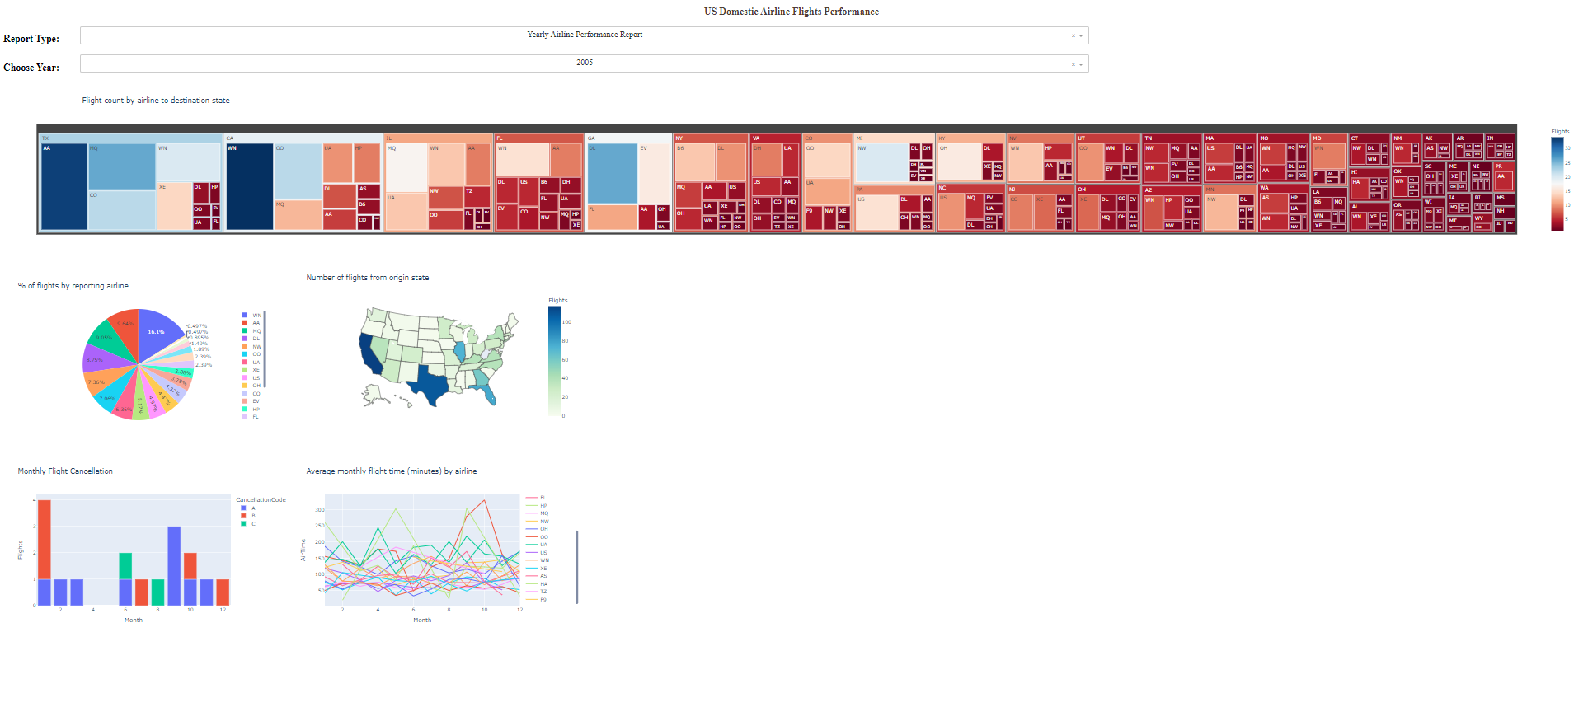
Yearly Airline Performance Report

Slide 75
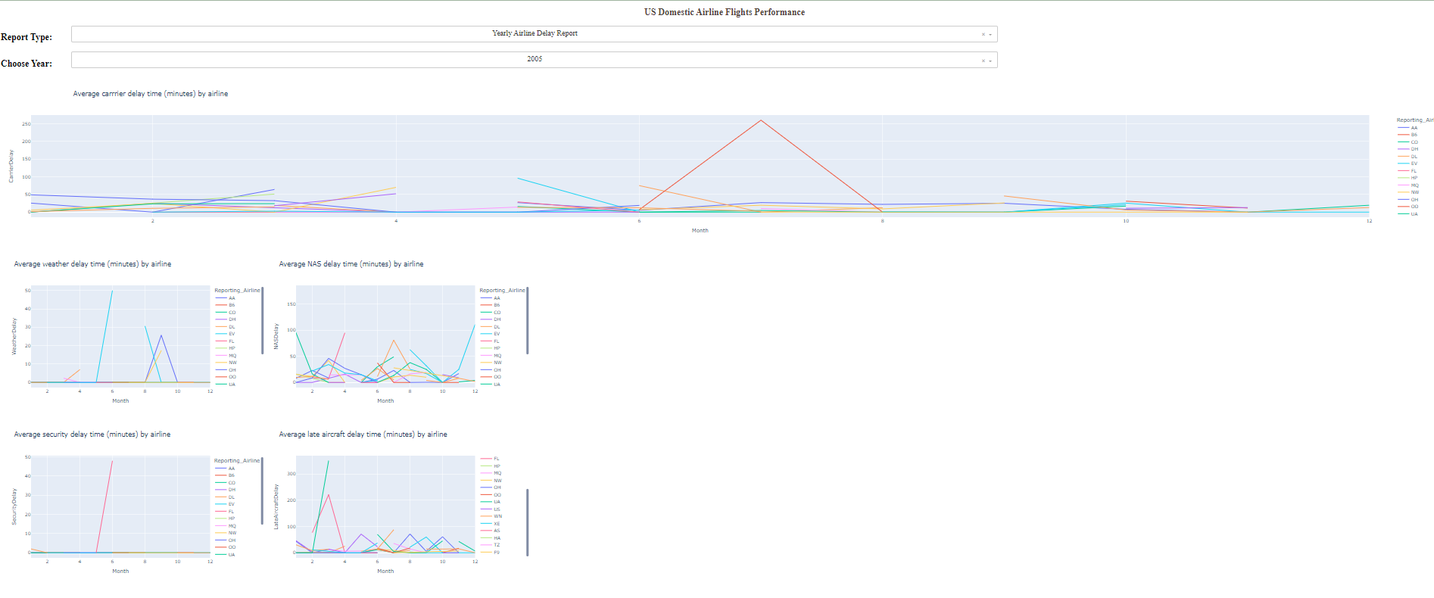
Yearly Airline Delay Report

Slide 76
Average Carrier Delay Time by Airline
Insights:
Evaluation of average carrier delay times by reporting airline over the year.
Identification of airlines contributing to higher average carrier delays.
Understanding the impact of carrier-related issues on flight schedules.

Slide 77
Average Weather Delay Time by Airline
Insights:
Analysis of average weather delay times experienced by different airlines.
Identification of airlines more prone to weather-related disruptions.
Understanding the extent to which weather affects airline operations.

Slide 78
Average NAS Delay Time by Airline
Insights:
Assessment of average NAS delay times for each reporting airline.
Identification of airlines affected by air traffic control or system-related delays.
Understanding the role of the national aviation system in flight delays.

Slide 79
Average Security Delay Time by Airline
Insights:
Analysis of average security delay times across reporting airlines.
Identification of airlines with higher or lower security-related delays.
Understanding the impact of security procedures on flight schedules

Slide 80
verage Late Aircraft Delay Time by Airline
Insights:
Evaluation of average late aircraft delay times for each airline.
Identification of airlines more prone to delays caused by previous late flights.
Understanding the influence of interconnected flights on punctuality.

Slide 81
Conclusion
In conclusion, this presentation has provided a comprehensive overview of our analysis and visualization of US domestic airline flight performance using the Dash web application.
We started by introducing Dash as a powerful Python web application framework that enables the creation of interactive and visually appealing data visualizations. Our focus was on analyzing and visualizing US domestic airline flight performance data, aiming to offer valuable insights into various aspects of airline operations.
We explored two main report types: the "Yearly Airline Performance Report" and the "Yearly Airline Delay Report." Through these reports, users can interact with the Dash web application, selecting specific years and report types to gain a deeper understanding of airline performance and flight delays.

Slide 82
Conclusion
The "Yearly Airline Performance Report" provided insights into monthly flight cancellations, average monthly flight times by airline, diverted airport landings, and flight counts by origin state. These visualizations empower users to assess overall airline performance throughout the year, understand trends, and identify potential areas for improvement.
The "Yearly Airline Delay Report" focused on different types of flight delays, including carrier, weather, NAS, security, and late aircraft delays. By visualizing and analyzing these delay types, users can gain valuable insights into the factors affecting flight punctuality and make informed decisions to enhance airline operations and passenger experiences.
Through this presentation, we demonstrated the capabilities of the Dash web application in transforming complex airline performance data into meaningful and interactive visualizations, thereby facilitating data-driven decision-making and fostering a deeper understanding of the aviation industry.

Slide 83
THANK YOU

